Slide 1







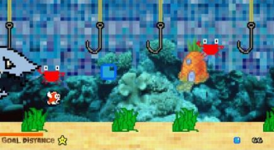
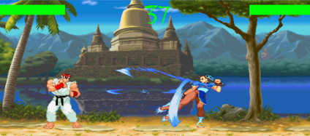
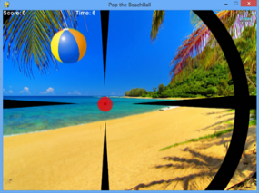
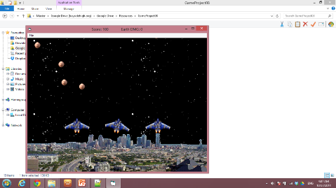
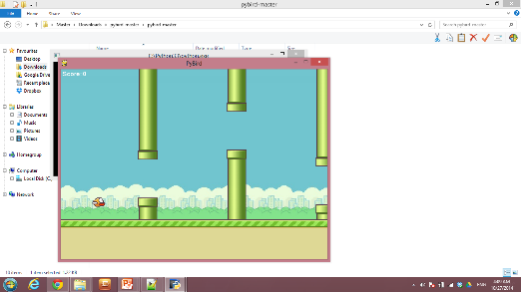
Let’s Play!
Game Development Workshop using Phaser
Notes:
1) These are some of the games produced by our students

Slide 2
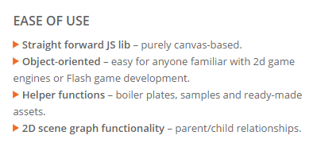

Game Engines
Most video games are developed using an engine. A game engine provides objects and functionality to help programmers design and create games. Phaser is a fast JavaScript game engine optimized for HTML5 development.
VROOM! Lets get this engine started.

Slide 3

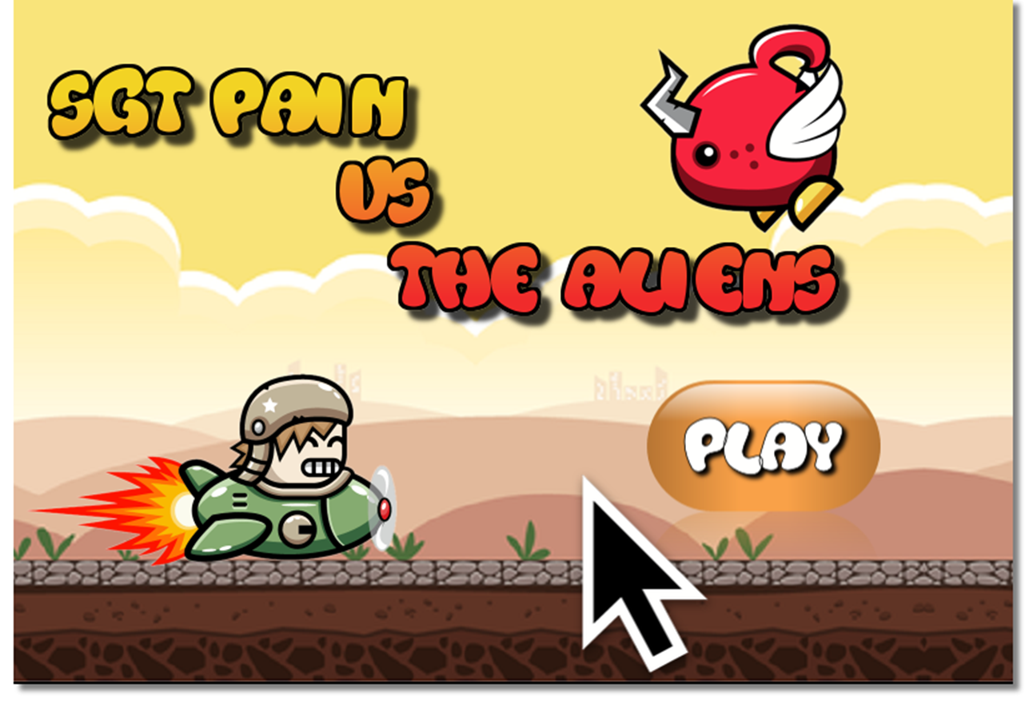
Resources
Our web based game, SGT Pain vs The Aliens consists of media files, a HTML 5 file, CSS file, the Phaser Game Engine and supporting JavaScript files.
Let’s keep it simple and get started.

Slide 4
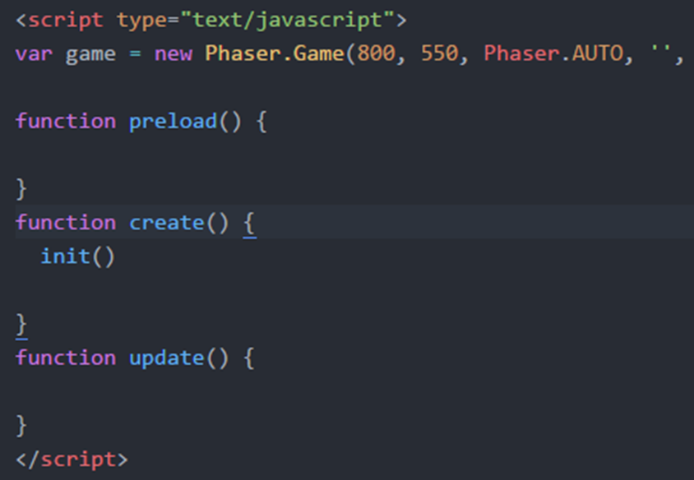
Index.html
Index.html loads the Phaser game engine, supporting JavaScript files and structure.
What happen to the assets?

Slide 5
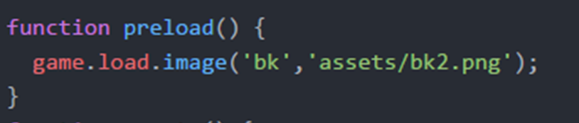
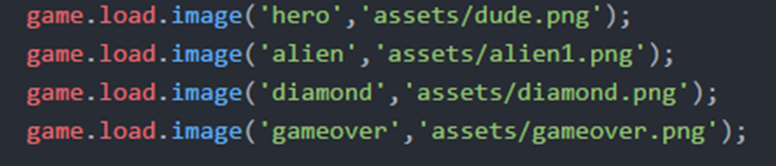
Assets
Assets such as pictures, animations and audio are loaded into the game in the preload function.
“id” for asset
Asset file with location
Let’s load up the rest of our graphic game assets.
Let’s get to the game!

Slide 6
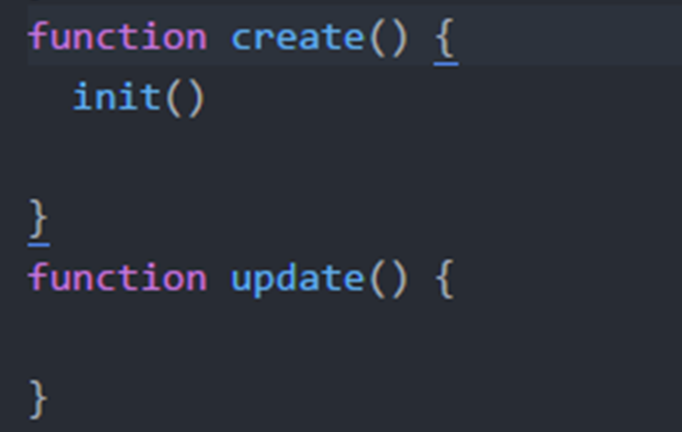

Create and Update
create ( ) is used as the name implies to create and initialize the game objects.
update ( ) is used to control the game objects as the game is playing.
Setup game objects
Gameplay logic
What game objects?

Slide 7
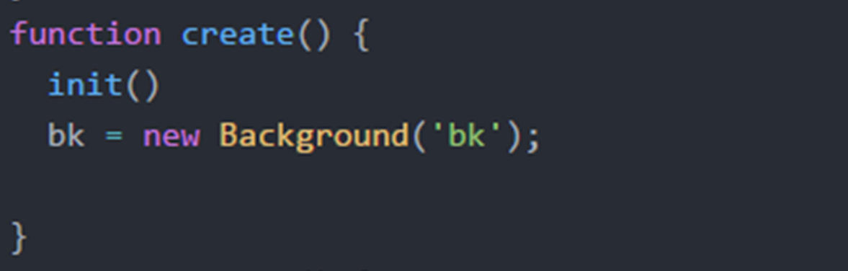

Game Objects
A game library was developed on top of Phaser to ease your introduction to game development. Game objects in the library consist of Background, Sprite, Text and Sound.
Background object
Variable to represent the background
id of the bk.png picture from assets
What can we do with a Background object?

Slide 8
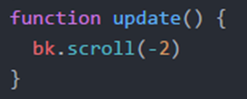
Game Object Functions
Each game object, Background, Sprite, Text and Sound have specific functions. Background objects are simple, you can only scroll them to the left or right.
Recall update ( ) is used for actions as the game is playing
scroll( ) function moves the background to the left if the value is negative
What other objects can we create?

Slide 9
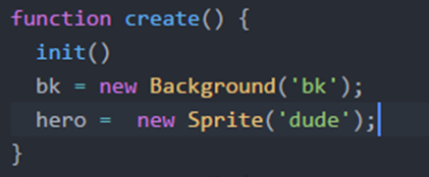
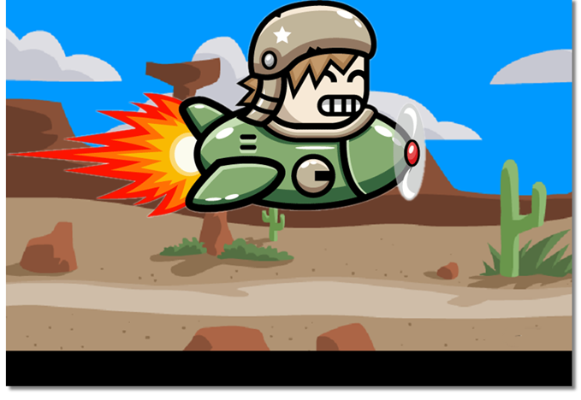
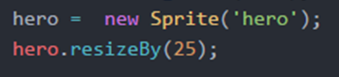
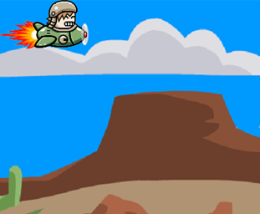
Sprite Object
Sprite objects are the backbone of any game. Sprite objects have many functions to control and manipulate them.
One useful function of sprites is the resizeBy( ) function.
Why is our hero not moving?

Slide 10
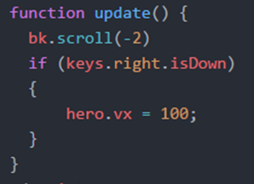
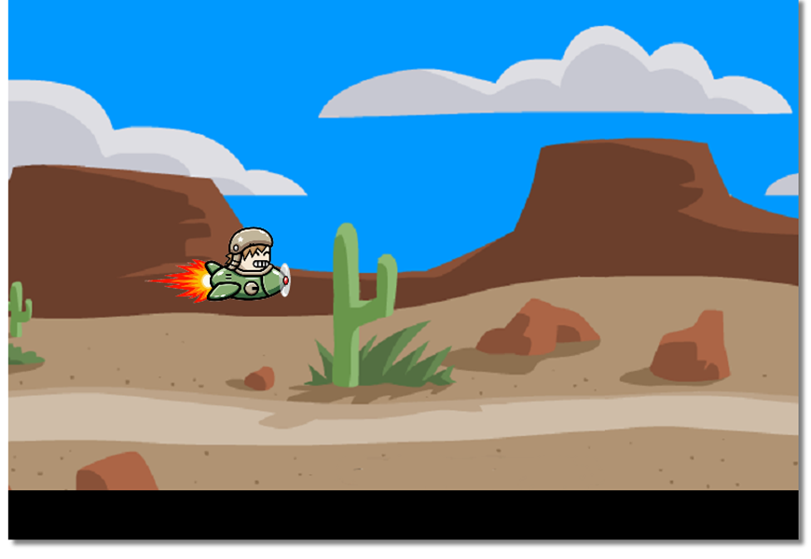
Moving Sprites
For this game we will control the hero with the arrow keys.
We can use an if statement to determine if the right arrow key is down. If it is then we set the hero’s x velocity.
In addition to functions, game objects also have useful variables.
Can you complete the other movement directions?

Slide 11
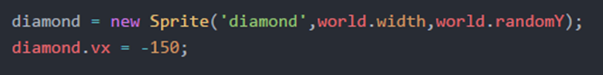

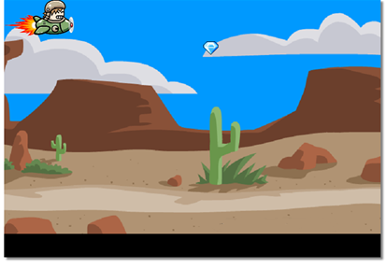
Practice
Can you create another sprite object for the diamond?.
When you create a sprite, you can provide the initial coordinates of the object.
world variable is useful for the dimensions of the game and locations.
Set the x velocity in order to move left.
Let’s keep a score for every diamond we collect.

Slide 12
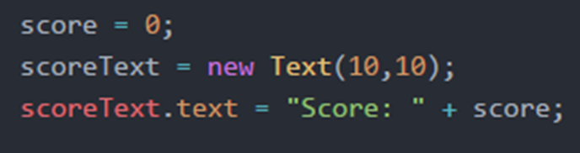
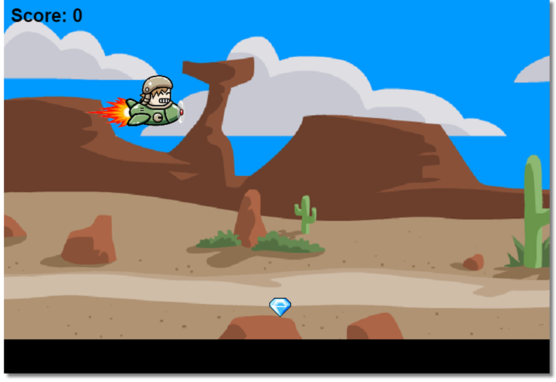
Text Objects & Score
Text objects allow the programmer to display textual information such as score.
Variables can store numerical information as well as objects.
Numeric variable for tracking the score
Create a text object at
coordinates (10, 10)
Display the score using the text variable of a Text object.
When should the score increase?

Slide 13
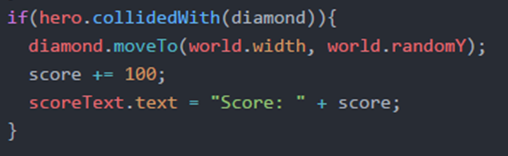
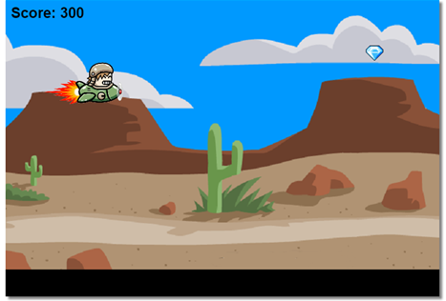
Collision
Essential to most games is the concept of collision. Sprite objects have a function collidedWith ( ) for checking collision with another sprite.
Checks if the hero has collided with the diamond.
moveTo ( ) allows you to position a sprite to a new location. We do this in order to fake an endless stream of diamonds.
Increase and display the score.
Our game is missing an enemy. It’s Practice Time!

Slide 14
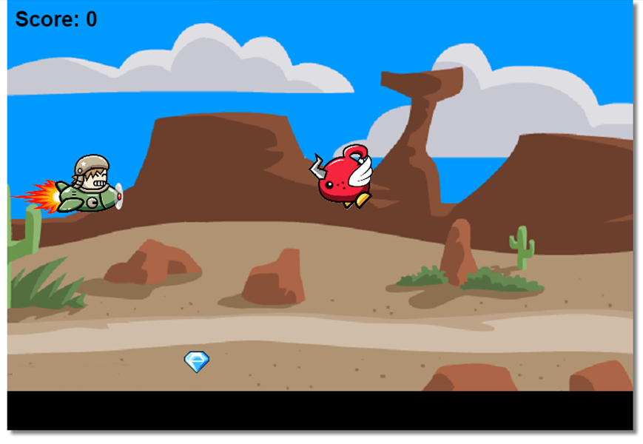
Practice
Can you create another sprite object for an alien at a random position off of the right side of the game and with similar motion like the diamond?
Can you create another text object like the score except it will be to track the hero’s health?
Can you create another decision checking to see if the hero has collided with the alien? If so, reposition the alien off the right side of the game, decrease and display the hero’s health just like we did with the diamond.
Every game needs a villain!

Slide 15
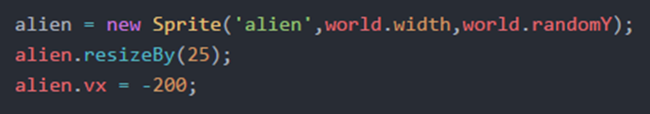
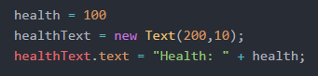
Practice (Solution)
Can you create another sprite object for an alien at a random position off of the right side of the game and with similar motion like the diamond?
Can you create another text object like the score except it will be to track the hero’s health?
There is more….

Slide 16
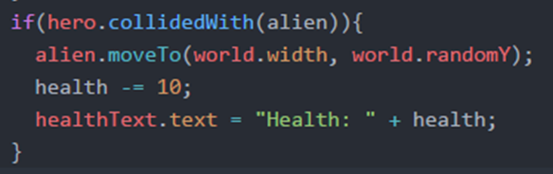
Practice (Solution)
Can you create another decision checking to see if the hero has collided with the alien? If so, reposition the alien off the right side of the game, decrease and display the hero’s health just like we did with the diamond.
Let’s recycle our diamonds and aliens if our hero does not collide with them.

Slide 17
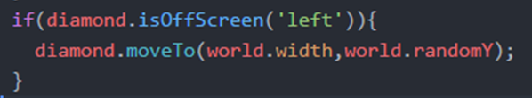
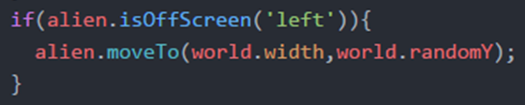
Off Screen
Another useful function of a sprite is the isOffScreen( ) function which can check if a sprite has moved off of the game.
If the diamond or alien manage to move off of the left side of the game, then lets randomly position them back to the right side of the game.
Does this game ever end?

Slide 18
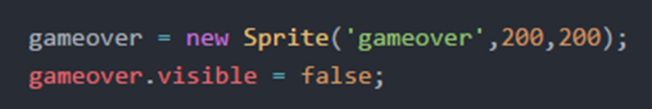
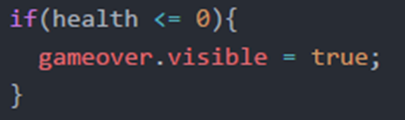
Game Over
Let’s end the game if our hero’s health goes below zero.
By default sprites are visible. We must change the visibility so that we don’t see it when the game starts.
We change the visibility of gameover when health reaches or drops below zero .
Our basic game is complete. Congratulations!

Slide 19
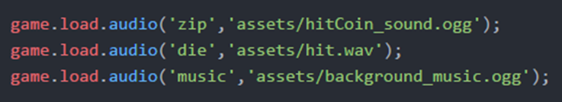
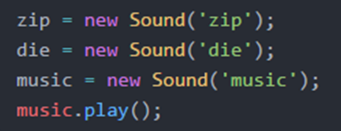
Sounds
Sounds add another dimension to the game. Sounds objects provide the ability to play( ) and loop a sound file.
Load the sounds files from the assets folder just like images.
NOTE! game.load.audio ( … ) instead of game.load.image (…)
Create Sound objects using the “id” of the audio just like images.
Let’s play sound when we collide with our objects.

Slide 20
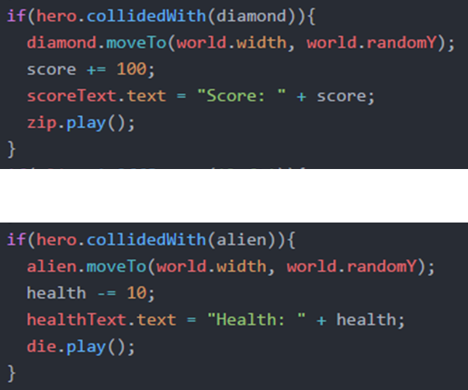
Sounds (cont.)
We can play sound objects whenever appropriate. In our game we will play sound files when we collide with the diamonds and aliens.
Music to my ears but how else can we enhance our game.

Slide 21
Enhancements
Though beyond the scope of this workshop below are a few examples of possible enhancements.
Add a starting and ending screens.
Add levels to the game with different types of aliens and movements.
Add purpose to collecting diamonds other than score. Perhaps our ship is fuelled by diamonds. In order to reach the end of a level, we must collect diamonds or run the risk of running out of fuel.
Add the ability to shoot the aliens.
End of level Boss!?
Wow! The options are endless.

Slide 22
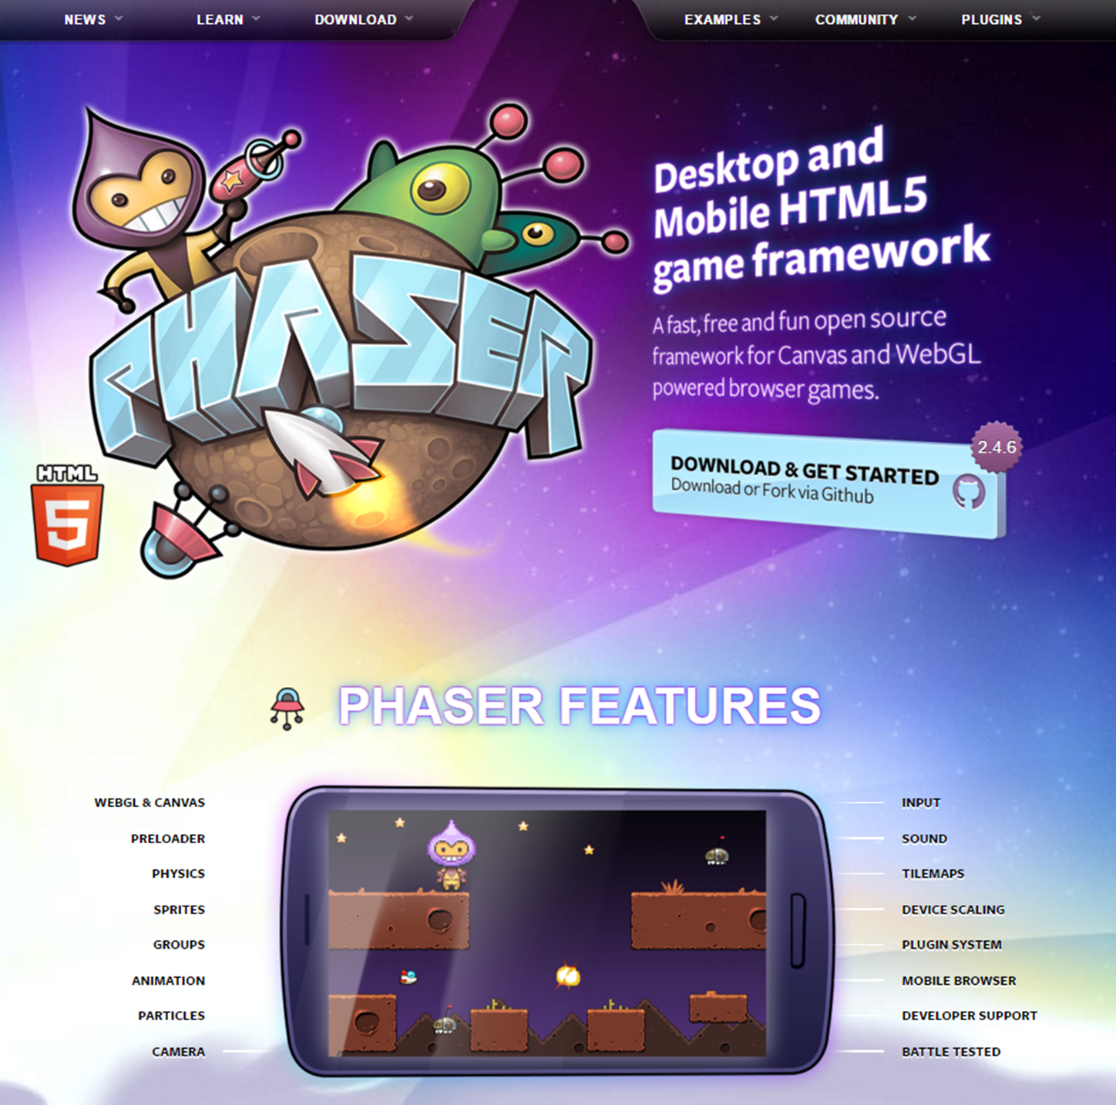
Game Development
Thank you for coming out to learn a little about
game development with Phaser.
Visit http://phaser.io to learn more.
Feel free to reach out to me at rcastro@baysidehighschool.org

